Slide 1

Wireless Networks
ICT-4107
By-
Dr. Jesmin Akhter
Professor
Institute of Information Technology
Jahangirnagar University

Slide 2
Contents
The course will mainly cover the following topics:
Wireless Networking
Multiple Access techniques
FDMA, TDMA and CDMA systems
Modulation Techniques
Analog and digital modulation techniques, Performance of various modulation techniques - Spectral efficiency, Error rate
The Cellular Concepts and System Design Fundamentals
Cellular concept and frequency reuse, Channel assignment and handoff, Interface and system capacity, Trunking and Erlang capacity calculations
Mobile Radio Propagation
Radio wave propagation issues in personal wireless systems, Propagation models, Multipath fading, Parameters of mobile multipath channels, Antenna systems in mobile radio.
Cellular Wireless Networks
Principles of Cellular Networks
First-Generation Analog
Second-Generation TDMA
Second-Generation CDMA
Third-Generation Systems

Slide 3
Outline
System Examples And Design Issues
Multiple Access Techniques
FDMA, TDMA and CDMA systems.

Slide 4
Multiple Access Techniques
Goal in the design of a cellular system to be able to handle as many calls as possible in a given bandwidth with the specified blocking probability.
Since the amount of spectrum available is limited, we need to find ways to allow multiple users to share the available spectrum simultaneously.
Multiple access schemes allow many users to share the radio spectrum.
Sharing the bandwidth efficiently among users is one of the main objectives of multiple access schemes
Notes:
Frequency spectrum of a signal is the range of frequencies contained by a signal
Frequency is the number of occurrences of a repeating event per unit of time.
Bandwidth is a range of frequencies within a given band, in particular that used for transmitting a signal

Slide 5
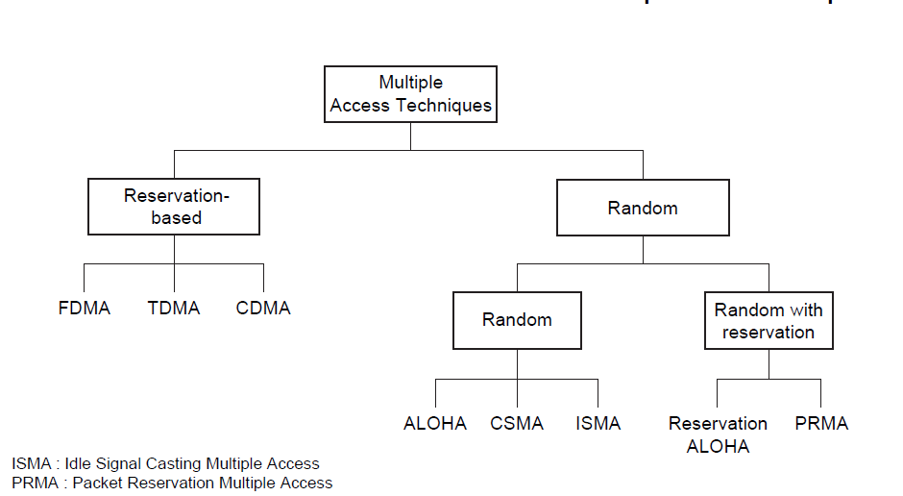
Classification: Multiple Access Techniques
Multiple access schemes can be classified as reservation-based multiple access (e.g., FDMA, TDMA, CDMA) and random multiple access (e.g., ALOHA, CSMA).

Slide 6
Multiple Access Techniques
If data traffic is continuous and a small transmission delay is required (for example in voice communication) reservation based multiple access is used.
the communication channel is based on FDMA, TDMA, or CDMA.
In many wireless systems for voice communication, the control channel is based on random multiple access
The reservation-based multiple access technique has a disadvantage in that once the channel is assigned, it remains idle if the user has nothing to transmit, while other users may have data waiting to be transmitted.
This problem is critical when data generation is random and has a high peak-rate to average-rate ratio.

Slide 7
Multiple Access Techniques
Random multiple access is more efficient, because a communication channel is shared by many users and users transmit their data in a random or partially coordinated fashion. ALOHA and carrier sense multiple access (CSMA) are examples of random multiple access.
If the data arrives in a random manner, and the data length is large, then random multiple access combined with a reservation protocol will perform better than both random- and reservation based schemes.

Slide 8
FDMA
Total system bandwidth is divided into narrow frequency slots.
FDMA assigns individual channels to individual users
A user is free to transmit or receive all the time on its allocated radio channel, but the cost of transceiver is high, as each has to be designed on a different band
Guard bands are maintained between adjacent signal spectra to minimize cross talk between channels
During the period of call no other user can share the same frequency band
Each user transmits with no limitations in time, but using only a portion of the whole available frequency bandwidth.
Different users are separated in the frequency domain
In frequency division duplex (FDD) systems, the users are assigned a channel as a pair of frequencies. One frequency is used for the upward channel, while the other frequency is used for the downward channel

Slide 9
FDMA-advantages
Capacity can be increased by reducing the information bit rate and using an efficient digital speech coding scheme
Technological advances required for implementation are simple. A system can be configured so that improvements in terms of a lower bit rate speech coding could be easily incorporated.
Hardware simplicity, because multiple users are isolated by employing simple bandpass filters.
Notes:
Speech coding is the process for reducing the bit rate of digital speech representation or transmission or storage, while maintaining a speech quality that is
acceptable for the application. Speech coding methods are classified as waveform coding, source coding, and hybrid coding.
The main function of bandpass filter in a transmitter is to limit the bandwidth of the output signal to the band allocated for the transmission. This prevents the transmitter from interfering with other stations.

Slide 10
FDMA-Disadvantages
FDMA wastes bandwidth. If an FDMA channel is not in use, then it sits idle and cannot be used by other users to increase or share capacity.
The FDMA mobile users unit uses duplexers since both the transmitter and receiver operate at the same time. A duplexers add weight, size and cost to a radio transmitter and can limit the minimum size of a subscriber unit
FDMA requires tight RF filtering to minimize adjacent channel interference
Notes:
RF filters are used within transmitters to ensure that unwanted or spurious signals are not transmitted

Slide 11
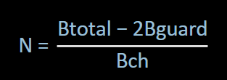
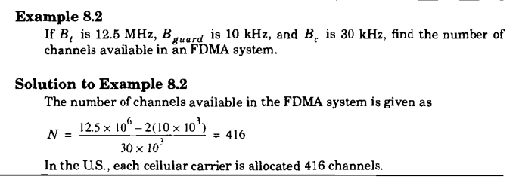
Numbers of Channels in FDMA
Let Btotal be the total system bandwidth, Bguard be the guard band at edge, and Bch the single radio channel bandwidth. Then the number of channels in a FDMA system:
Notes:
Rappaport Example

Slide 12
TDMA
In digital systems, continuous transmission is not required because users do not use the allotted bandwidth all the time. In such cases, TDMA is a complimentary access technique to FDMA.
In TDMA, the entire bandwidth is available to the user but only for a finite period of time. In most cases the available bandwidth is divided into fewer channels compared to FDMA and the users are allotted time slots during which they have the entire channel bandwidth at their disposal.
TDMA requires careful time synchronization since users share the bandwidth in the frequency domain.
The number of channels are less, inter channel interference is almost negligible.
TDMA uses different time slots for transmission and reception. This type of duplexing is referred to as Time division duplexing(TDD).

Slide 13
TDMA
Guard times are used between each user’s transmission to minimize cross talk between channels.
In a TDMA/TDD system, half of the time slots in the frame information message would be used for the forward link channels and half would be used for reverse link channels.
In TDMA/FDD systems, the carrier frequencies would be different for the forward and reverse links.
GSM (Global Systems for Mobile communications) uses a TDMA technique, where the carrier is 200 kHz wide and supports eight full rate channels.
A channel (roughly) consists of the recurrence every 4.6 ms of a time slot of 0.58 ms.

Slide 14
Features of TDMA
TDMA shares a single carrier frequency with several users where each users makes use of non overlapping time slots.
The number of time slots per frame depends on several factors such as modulation technique, available bandwidth etc.
Data transmission in TDMA is not continuous but occurs in bursts. This results in low battery consumption since the subscriber transmitter can be turned OFF when not in use. Because of a discontinuous transmission in TDMA the handoff process is much simpler for a subscriber unit, since it is able to listen to other base stations during idle time slots.
TDMA uses different time slots for transmission and reception thus duplexers are not required.
TDMA can be easily adapted to the transmission of data as well as voice communication.
TDMA has an advantage that is possible to allocate different numbers of time slots per frame to different users. Thus bandwidth can be supplied on demand to different users by concatenating or reassigning time slot based on priority.
Notes:
A burst is a transmission involving a large amount of data sent in a short time

Slide 15
Features of TDMA
Permits flexible rates (i.e. several slots can be assigned to a user, for example, each time interval translates 32Kbps, a user is assigned two 64 Kbps slots per frame).
Can withstand variable bit rate traffic. Number of slots allocated to a user can be changed frame by frame (for example, two slots in the frame 1, three slots in the frame 2, one slot in the frame 3, …etc.).
No guard band required for the wideband system.
No narrowband filter required for the wideband system.

Slide 16
Disadvantages
For mobiles and particularly for hand-sets, TDMA on the uplink demands high peak power in transmit mode, that shortens battery life.
TDMA requires a substantial amount of signal processing for matched filtering and correlation detection for synchronizing with a time slot.
TDMA requires synchronization. If the time slot synchronization is lost, the channels may collide with each other.
One complicating feature in a TDMA system is that the propagation time for a signal from a mobile station to a base station varies with its distance to the base station.

Slide 17
Number of channels in TDMA system
The number of TDMA channel slots that can be provided in a TDMA system is found by multiplying the number of TDMA slots per channel by the number of channels available and is given by
N = m(BTot — 2Bguard)/Bc
where m is the maximum number of TDMA users supported on each radio channel. Note that two guard bands, one at the low end of the allocated frequency band and one at the high end, are required to ensure that users at the edge of the band do not "bleed over" into an adjacent radio service.
Notes:
bleed over-contamination

Slide 18
Number of channels in TDMA system
Example 8.3
Consider Global System for Mobile, which is a TDMA/FDD system that uses 25 MHz for the forward link, which is broken into radio channels of 200 kHz. If speech channels are supported on a single radio channel, and if no guard band is assumed, find the number of simultaneous users that can be accommodated in GSM.
Solution
The number of simultaneous users that can be accommodated in GSM is given as
N =8*25MHz/(200 kHz)
=1000
Thus, GSM can accommodate 1000 simultaneous users.
Notes:
Rappaport Example

Slide 19
Example 8.4
If GSM uses a frame structure where each frame consists of 8 time slots, and each time slot contains 156.25 bits, and data is transmitted at 270.833 kbps in the channel, find (a) the time duration of a bit, (b) the time duration of a slot, (c) the time duration of a frame, and (d) how long must a user occupying a single time slot must wait between two simultaneous transmissions.
Solution
The time duration of a bit, Tb = 1/270.833 kbps = 3.692 µs
The time duration of a slot, TSlot= 156.25 x Tb = 0.577 ms.
(c) The time duration of a frame, Tf, = 8 x TSlot = 4.615 ms.
(d) A user has to wait 4.615 ms, the arrival time of a new frame, for its next transmission.

Slide 20
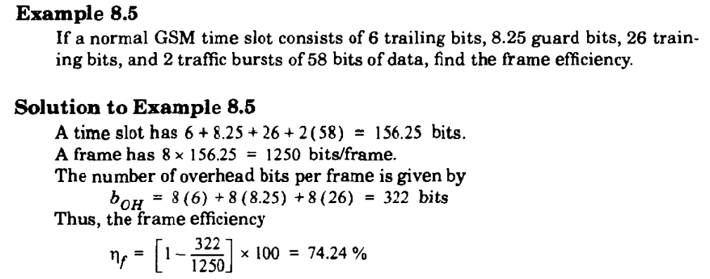

Slide 21
Spectral Efficiency
An efficient use of the spectrum is the most desirable feature of a mobile communications system. To realize this, a number of techniques have been proposed or already implemented. Some of these techniques used to improve spectral efficiency are reducing the channel bandwidth, information compression (low-rate speech coding), variable bit rate codec, improved channel assignment algorithms (dynamic channel assignment), and so on.
Spectral efficiency of a mobile communications system shows how efficiently the spectrum is used by the system. Spectral efficiency of a mobile communications system depends on the choice of a multiple access scheme.
The measure of spectral efficiency enables one to estimate the capacity of a mobile communications system.
The overall spectral efficiency of a mobile communications system can be estimated by knowing the modulation and the multiple access spectral efficiencies separately.

Slide 22
Multiple Access Spectral Efficiency
Multiple access spectral efficiency is defined as the ratio of the total time or frequency dedicated for traffic transmission to the total time or frequency available to the system.
The multiple access spectral efficiency is a dimensionless. In FDMA, users share the radio spectrum in the frequency domain.
In FDMA, the multiple access efficiency is reduced because of guard bands between channels and also because of signaling channels.
In TDMA, the efficiency is reduced because of guard time and synchronization sequence.

Slide 23
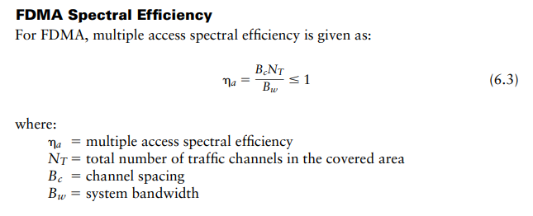
Multiple Access Spectral Efficiency

Slide 24
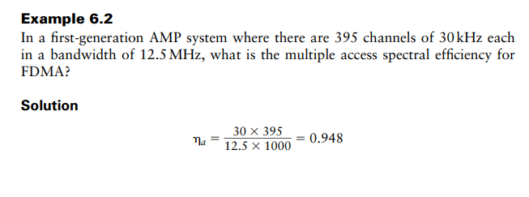
Multiple Access Spectral Efficiency

Slide 25
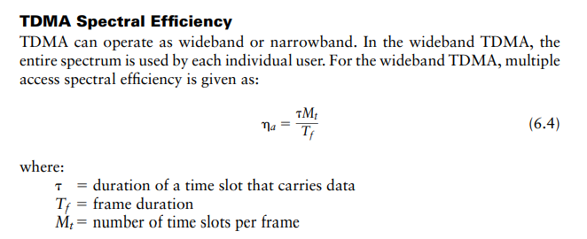
Multiple Access Spectral Efficiency

Slide 26
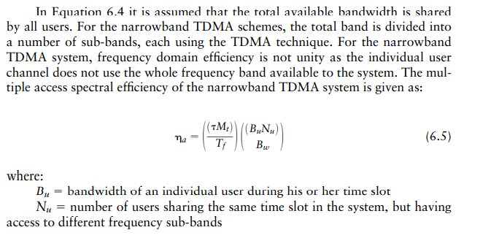
Multiple Access Spectral Efficiency(TDMA)

Slide 27
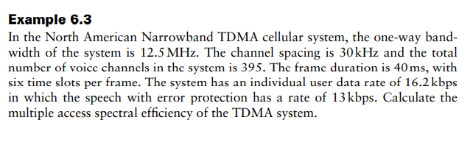
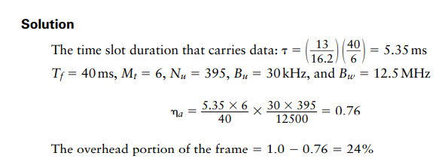

Slide 28
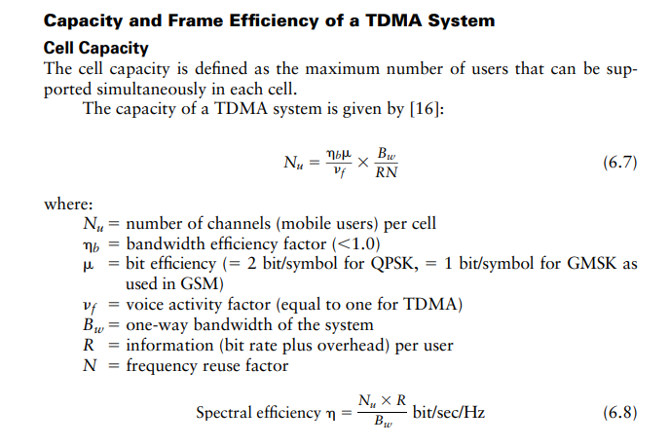

Slide 29
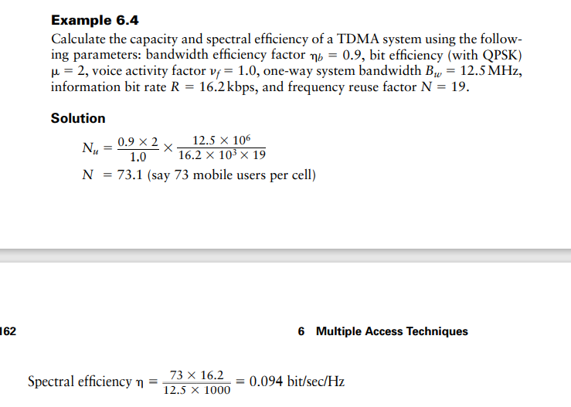

Slide 30
Spread Spectrum Multiple Access
Spread spectrum multiple access (SSMA) uses signals which have a transmission bandwidth that is greater than the minimum required RF bandwidth. A pseudo-noise (PN) sequence converts a narrowband signal to a wideband noise-like signal before transmission.
SSMA also provides immunity to multipath interference and robust multiple access capability.
SSMA is not very bandwidth efficient when used by a single user. However, since many users can share the same spread spectrum bandwidth without interfering with one another, spread spectrum systems become bandwidth efficient in a multiple user environment. It is exactly this situation that is of interest to wireless system designers.
Notes:
Spread spectrum involves the use of a much wider BW than actually necessary to support a given data rate.

Slide 31
Spread Spectrum Multiple Access Gains
SSMA provides immunity to multipath interference and robust multiple access capability.
Immunity from various noise and multipath distortion
Including jamming
Can hide/encrypt signals
Only receiver who knows spreading code can retrieve signal
Several users can share same higher bandwidth with little interference
Drastically reduce BER
So the result of using wider BW is to minimize interference and drastically reduce BER.

Slide 32
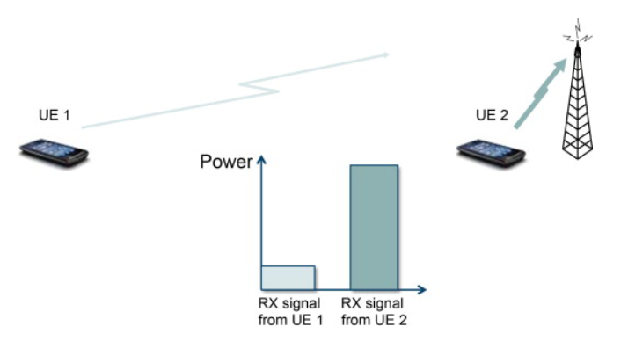
Problem
A problem can arise when the signals from different users are received at very different power levels, for example, because in the uplink one user is close to the base station whereas a second user is not, as shown in Figure.
Stronger received signal levels raise the noise floor at the base station for the weaker signals, thereby decreasing the probability that weaker signals will be received.
In this case, the spreading gain will not be able to suppress the interference from the (strong) second user’s transmission sufficiently and the reception of the first user will experience a poor signal-to-interference ratio because of interference from the second user. This problem is known as the “near-far” problem and is mitigated by the use of power control that keeps the receive power from different transmissions at appropriate levels (depending on the users’ relative data rates). Power control is provided by each base station in a cellular system and assures that each mobile within the base station coverage area provides the same signal level to the base station receiver.
Notes:
The Noise Floor is the signal created from adding up all the unwanted signals within a measurement system. The noise floor consists of noise from a number of sources which includes thermal noise, atmospheric noise and noise from components used to make the measurement system.

Slide 33
Types of Spread Spectrum Multiple Access
There are two fundamental types of spread spectrum systems:
(1) Direct Sequence Multiple Access(DSMA) and
(2) frequency hopping Multiple Access (FHMA)
Notes:
SSMA also provides immunity to multipath interference and robust multiple access capability.
The result of using wider BW is to minimize interference and drastically reduce BER.
It operates in 2.4GHz band at data rate of 1Mbps and 2Mbps.
There are two main types of spread spectrum multiple access techniques; frequency hopped multiple access (FH) and direct sequence multiple access (DS). Direct sequence multiple access is also called code division multiple access (CDMA)

Slide 34
Direct Sequence Multiple Access(DSMA)
In a DSMA system, the bandwidth of the baseband information carrying signals from a different user is spread by different codes with a bandwidth much larger than that of the baseband signals.
The spreading codes used for different users are orthogonal or nearly orthogonal to each other.
In the DSMA, the spectrum of the transmitted signal is much wider than the spectrum associated with the information rate.
At the receiver, the same code is used for despreading to recover the baseband signal from the target user while suppressing the transmissions from all other users.

Slide 35
Direct Sequence Spread Spectrum (DSSS)
Each bit represented by multiple bits using spreading code
Spreading code spreads signal across wider frequency band
In proportion to number of bits used
10 bit spreading code spreads signal across 10 times bandwidth of 1 bit code
One method:
Combine input with spreading code using XOR
Input bit 1 inverts spreading code bit
Input zero bit doesn’t alter spreading code bit
Data rate equal to original spreading code
Performance similar to FHSS

Slide 36
Direct Sequence Multiple Access(DSMA)
CDMA is a Direct Sequence Spread Spectrum system. The CDMA system works directly on 64 kbit/sec digital signals.
In CDMA, each bit time is subdivided into m short intervals called chips. Typically there are 64 or 128 chips per bit. Each station is assigned a unique m-bit chip sequence.
To transmit a 1 bit, a station sends its chip sequence.
To transmit a 0 bit, it sends the one's complement of its chip sequence.
No other patterns are permitted.
Thus for m = 8, if station A is assigned the chip sequence 00011011, it sends a 1 bit by sending 00011011 and a 0 bit by sending 11100100.

Slide 37
Direct Sequence Multiple Access(DSMA)
Increasing the amount of information to be sent from b bits/sec to mb chips/sec can only be done if the bandwidth available is increased by a factor of m, making CDMA a form of spread spectrum communication.
In order to protect the signal, the chip sequence code used is pseudo-random. It appears random, but is actually deterministic, so that the receiver can reconstruct the code for synchronous detection. This pseudo-random code is also called pseudo-noise (PN).

Slide 38
CDMA encode/decode
channel output Z_{i,m}
Z_{i,m}= d_{i}.c_{m}
data
bits
d₀ = 1
1
1
1
1
1
d₁ = -1
1
1
1
-
-
-
-
1
-
-
-
1
-
1
1
1
1
1
sender
1
1
slot 1
channel
output
slot 0
channel
output
1
1
1
1
1
code
1
1
-
-
-
1
-
1
1
1
-
-
-
1
-
1
1
1
slot 1
slot 0
M
D_{i} = Σ Z_{i,m}.c_{m}
m=1
M
received
input
1
1
1
1
1
1
1
1
d₀ = 1
-
-
-
-
1
-
-
-
1
-
1
1
1
1
1
1
d₁ = -1
1
slot 1
channel
output
slot 0
channel
output
1
1
1
1
1
code
1
1
-
-
-
1
-
1
1
1
-
-
-
1
-
1
1
1
receiver
slot 1
slot 0

Slide 39
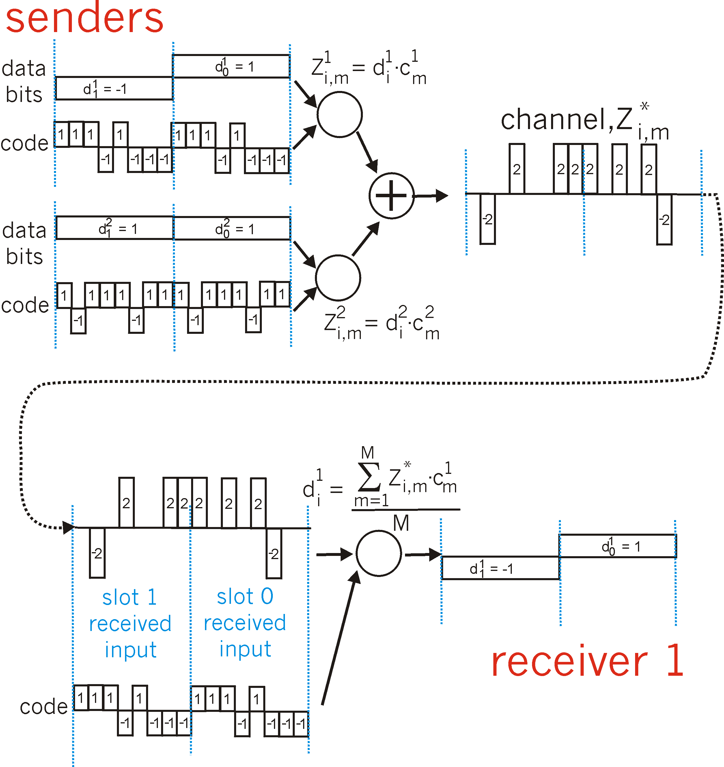
CDMA: two-sender interference
channel sums together transmissions by sender 1 and 2
Sender 1
Sender 2
using same code as sender 1, receiver recovers sender 1’s original data from summed channel data!

Slide 40
Frequency Hopped Multiple Access (FHMA)
Frequency hopped multiple access (FHMA) is a digital multiple access system in which the carrier frequencies of the individual users are varied in a pseudorandom fashion within a wideband channel.
The digital data is broken into uniform sized bursts which are transmitted on different carrier frequencies.
The instantaneous bandwidth of any one transmission burst is much smaller than the total spread bandwidth.
The pseudorandom change of the carrier frequencies of the user randomizes the occupancy of a specific channel at any given time, thereby allowing for multiple access over a wide range of frequencies.
In the FH receiver, a locally generated PN code is used to synchronize the receivers instantaneous frequency with that of the transmitter.

Slide 41
Frequency Hopped Multiple Access (FHMA)
The difference between FHMA and a traditional FDMA system is that the frequency hopped signal changes channels at rapid intervals.
A frequency hopped system provides a level of security, especially when a large number of channels are used, since an unintended (or an intercepting) receiver does not know the pseudorandom sequence of frequency slots
In addition, the FH signal is somewhat immune to fading. In case of FHSS, spread spectrum is achieved by frequently jumping from one carrier frequency to another; thus if there is interference or performance degradation at a given frequency, it only affects a small fraction of transmission.
The amount of time spent at each frequency, the dwell time, is an adjustable parameter but must be less than 400 ms.
Operates at 2.4 GHz band at data rate of 1Mbps and 2Mbps

Slide 42
Frequency Hopped Multiple Access (FHMA)
Types of frequency hopping are:
(I) Slow frequency hopping
(2) Fast frequency hopping
Slow-frequency hopping- In slow frequency hoping several symbols are transmitted corresponding to each frequency hopping. Therefore each frequency hopping several symbols i.e. frequency hopping takes place slowly.
Fast frequency hopping- In the fast frequency hopping during the transmission of one symbol, the carrier frequency will hop several times. Therefore each symbol transmission several frequencies hops. Thus- the frequency hopping takes place at a fast rate.

Slide 43
Spreading Sequences
Spreading sequences are very important in the design of spread spectrum communication
Two categories of Spreading Sequences
PN sequences
Orthogonal codes
FHSS systems
PN sequences most common
DSSS CDMA systems
PN sequences
Orthogonal codes

Slide 44
PN Sequences
PN sequences are periodic but appear random within one period
PN sequences are very easy to generate
Generated using LFSR
PN sequences are easy to re-generate and synchronize at the receiver
PN sequences have good random properties
linear-feedback shift register - LFSR

Slide 45
Linear-feedback shift register
A linear-feedback shift register (LFSR) is a shift register whose input bit is a linear function of its previous state.
The most commonly used linear function of single bits is exclusive-or (XOR). Thus, an LFSR is most often a shift register whose input bit is driven by the XOR of some bits of the overall shift register value.
The initial value of the LFSR is called the seed, and because the operation of the register is deterministic, the stream of values produced by the register is completely determined by its current (or previous) state. Likewise, because the register has a finite number of possible states, it must eventually enter a repeating cycle. However, an LFSR with a well-chosen feedback function can produce a sequence of bits that appears random and has a very long cycle.

Slide 46
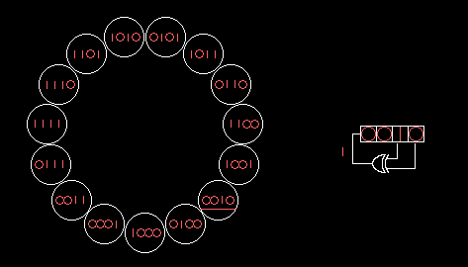
Linear-feedback shift register
A 4-bit Fibonacci LFSR with its state diagram. The XOR gate provides feedback to the register that shifts bits from left to right.

Slide 47
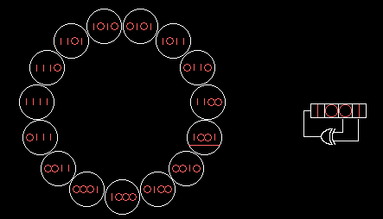
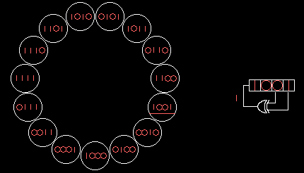
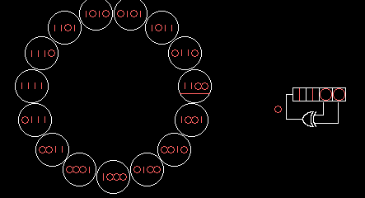
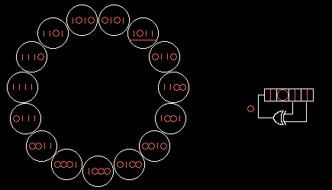
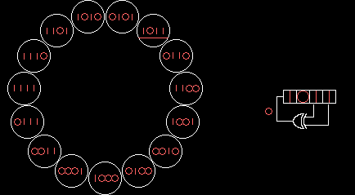
Linear-feedback shift register
A 4-bit Fibonacci LFSR with its state diagram. The XOR gate provides feedback to the register that shifts bits from left to right.

Slide 48
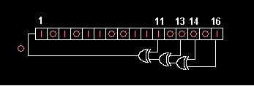
Linear-feedback shift register
16-bit Fibonacci LFSR

Slide 49
Thank You

